Slide 1

Notes:
Intro slide left blank intentionally - CJ

Slide 2
Should the Kansas City Chiefs pay Patrick Mahomes $500 Million Dollars?

Slide 3
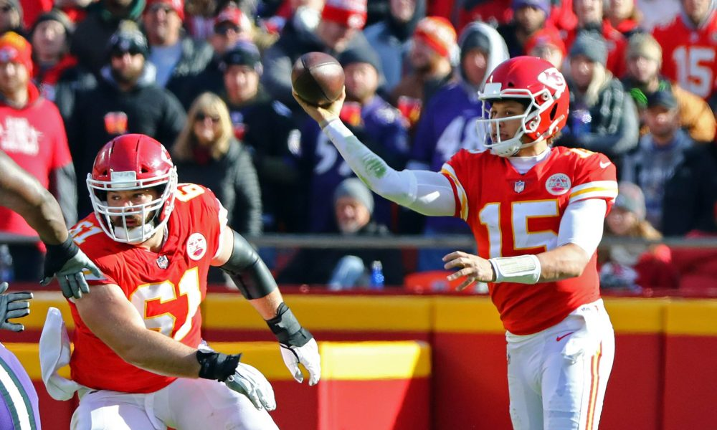
Yes
Picture source: https://usatchiefswire.files.wordpress.com/2019/01/usatsi_11817213-1-e1547655625271.jpg?w=1000&h=600&crop=1
Notes:
https://usatchiefswire.files.wordpress.com/2019/01/usatsi_11817213-1-e1547655625271.jpg?w=1000&h=600&crop=1

Slide 4
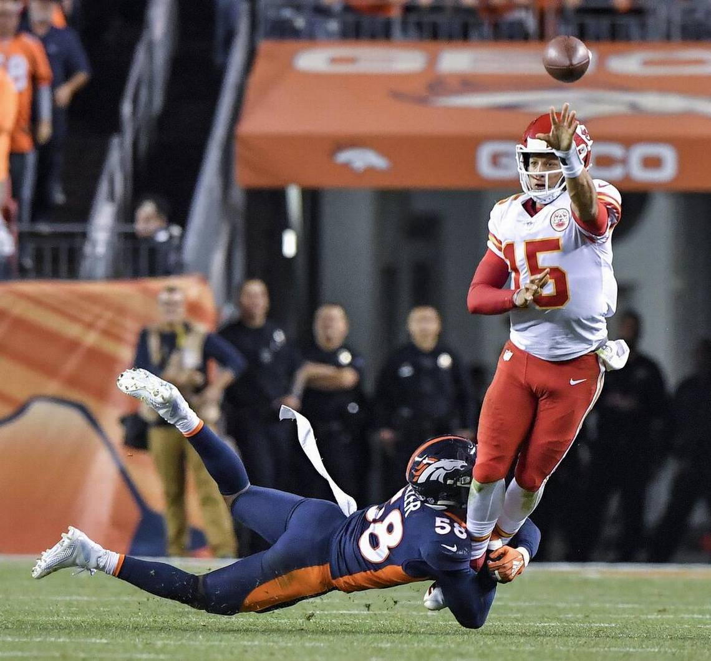
Yes
Picture source: https://www.kansascity.com/sports/nfl/kansas-city-chiefs/chiefs-photos-videos/ug1d67/picture219356860/alternates/
FREE_1140/ChiefsBroncos%201524%2010-1-18
Notes:
https://www.kansascity.com/sports/nfl/kansas-city-chiefs/chiefs-photos-videos/ug1d67/picture219356860/alternates/FREE_1140/ChiefsBroncos%201524%2010-1-18

Slide 5
Yes
Picture source: https://cdn.vox-cdn.com/thumbor/3WklbZ6034Hf0zcZqd4HNmQMoCg=/0x0:7777x5185/920x613/filters:focal(3278x1562:4522x2806):
format(webp)/cdn.vox-cdn.com/uploads/chorus_image/image/62988443/usa_today_12099350.0.jpg
Notes:
https://cdn.vox-cdn.com/thumbor/3WklbZ6034Hf0zcZqd4HNmQMoCg=/0x0:7777x5185/920x613/filters:focal(3278x1562:4522x2806):format(webp)/cdn.vox-cdn.com/uploads/chorus_image/image/62988443/usa_today_12099350.0.jpg

Slide 6
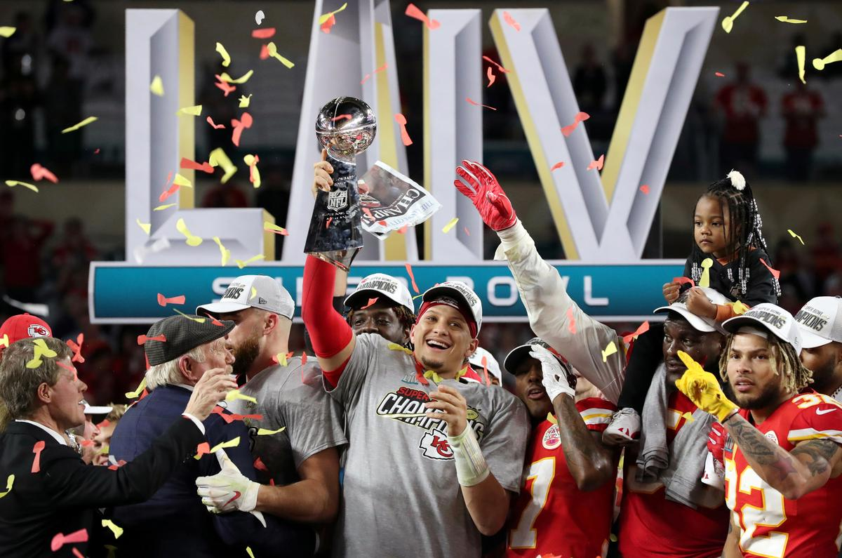
Yes
Picture source: https://s3.reutersmedia.net/resources/r/?m=02&d=20200203&t=2&i=1485280412&w=1200&r=LYNXMPEG1213Q
Notes:
https://s3.reutersmedia.net/resources/r/?m=02&d=20200203&t=2&i=1485280412&w=1200&r=LYNXMPEG1213Q

Slide 7
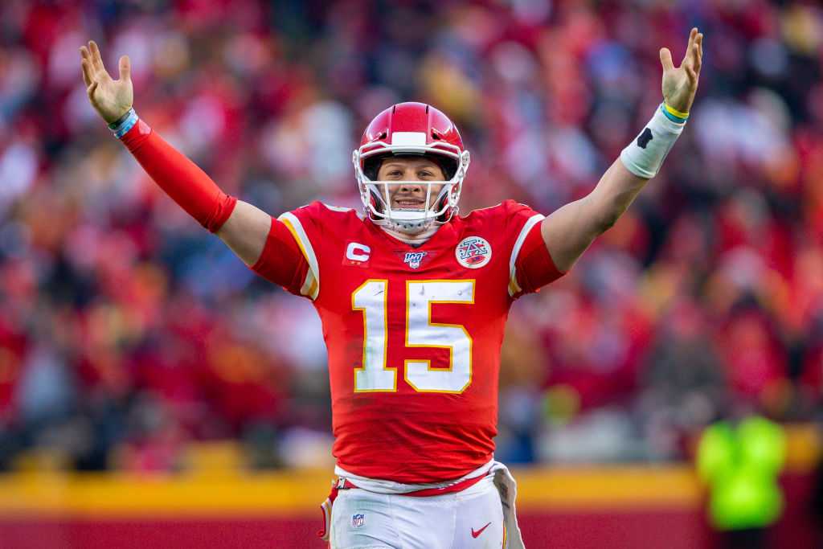
Yesssssssss
Picture source: https://www.sportscasting.com/wp-content/uploads/2020/01/Kansas-City-Chiefs-quarterback-Patrick-Mahomes-1.jpg

Slide 8
Fantasy Football Predictions with Random Forest
Notes:
Our goal was to take data from previous football seasons and try to use machine learning to determine if it could help predict future success.
We also wanted to find if any players would regularly exceed or fall behind their projected output
Finally use Tableau to present our findings in an interactive way

Slide 9
Choosing a Data Source
Several sites online offer various combinations of NFL data
ESPN.com and NFL.com have stats available for over 10+ seasons
Data is already summarized by season
NFL-provided API requires authorization tokens
Pro-football-reference.com
NFLScrapR
Kaggle – NFL Football Player Stats
Data scraped from Pro-football-reference.com
Game-by-game stats for over 25,000 players
Data compiled into 2 JSON files
Notes:
We could have used BeautifulSoup to scrape data from ESPN, NFL, PFR.com
PFR has every NFL season since 1920
Weren’t able to find a PFR API
https://github.com/maksimhorowitz/nflscrapR
NFLScrapR is a free, open source data collection available on Github
https://www.kaggle.com/zynicide/nfl-football-player-stats/data#
Kaggle data scraped in 2017
Already loaded into 2 JSONs – able to hit the ground running

Slide 10
Cleaning the Data
Jupyter Notebook to read in JSON data
Pandas function read_json quickly read data into data frames
Remove unimportant columns
Update and modernize player position assignment
Notes:
Two JSONs/Data Frames – 1 with player biographical information, 1 with game log – matching Player ID#
The games JSON data included 46 columns worth of data
Games won/lost, death date, birthplace, high school and college
Two issues with positions – Multiple positions assigned
Kaggle data included positions that were more common in pre-NFL football
(Flanker, Split End, Wing Back, Tailback)

Slide 11
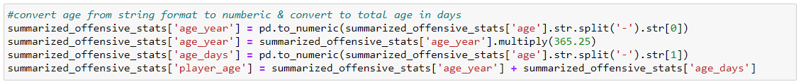
Even more data cleaning
Age was formatted as a string - Years-Days
Height was formatted as a string - Feet-Inches
Filter data to only include games and players at Top 4 fantasy football positions
Notes:
Converted the age into total days old (Instead of 28 years old, 10227 days old)
Converted height into total inches (6-4 becomes 76 inches) Converted/substituted down to 4 most common Fantasy positions (QB, RB, WR, TE)
Defenses and kickers don’t matter

Slide 12
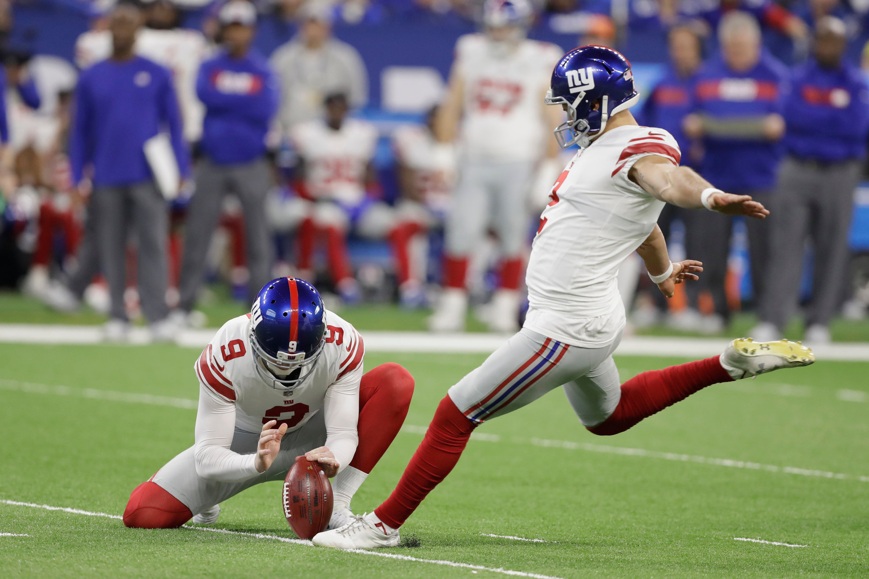
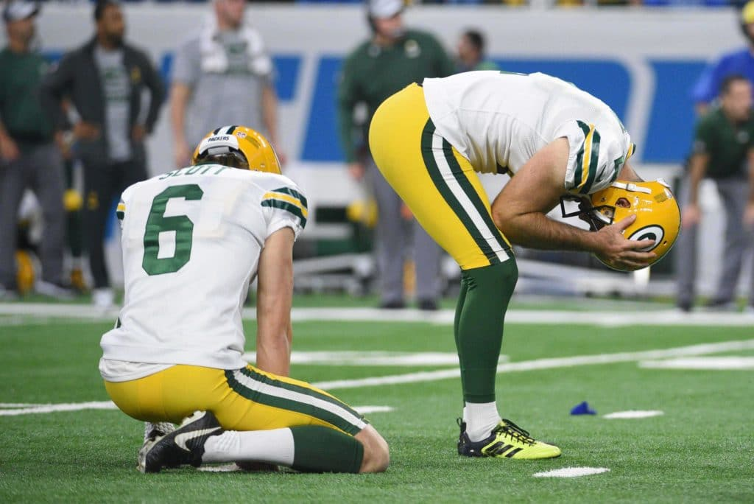
Kickers Don’t Matter
Pro Football Focus Kickers Research: https://www.pff.com/news/fantasy-football-metrics-that-matter-kickers
Left picture source: https://static01.nyt.com/images/2019/08/14/sports/14nfl-kickers2/merlin_148451919_0cba315c-799a-438a-
83a1-2b8155246ecd-superJumbo.jpg
Right picture source: https://cdn.theathletic.com/app/uploads/2018/11/26025125/Crosby_USAT-1024x684.jpg
Notes:
Packers picture: https://cdn.theathletic.com/app/uploads/2018/11/26025125/Crosby_USAT-1024x684.jpg
Giants picture: https://static01.nyt.com/images/2019/08/14/sports/14nfl-kickers2/merlin_148451919_0cba315c-799a-438a-83a1-2b8155246ecd-superJumbo.jpg
Pro Football Focus - https://www.pff.com/news/fantasy-football-metrics-that-matter-kickers
In short: kickers are difficult to predict and the difference between Top 10 is smaller than any other position group

Slide 13
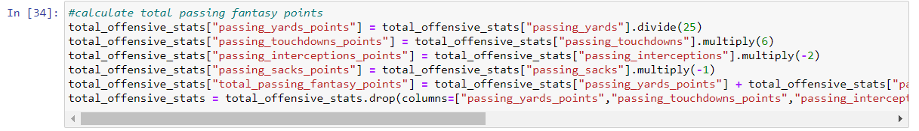
Calculating the Fantasy Points
Dataset included specific stats but not fantasy points
Calculations made using ESPN standard scoring with 6 points for a QB Touchdown
Notes:
For those who don’t play fantasy football, because quarterbacks score many more touchdowns than other positions, some leagues score passing TDs as 4 points
Those leagues are wrong; touchdowns are worth 6 points.

Slide 14
Summarizing Data and Combining DataFrames
Summarized stats by player and year
Merged with the Player Biographical DataFrame
Notes:
While we had hoped that Home/Road splits or Team would be significant, when we got into the machine learning we did not find much significance
Merged so we could see Player Name on the stats and make it slightly more readable

Slide 15
Neural Networks
Attempted to build either a ANN, or CNN
Ran into issues with categorically data having a negative impact on the model

Slide 16
Building the Model
Used TensorFlow, pandas, numpy, OneHotEncoder
The type of model chosen was the Sequential model

Slide 17
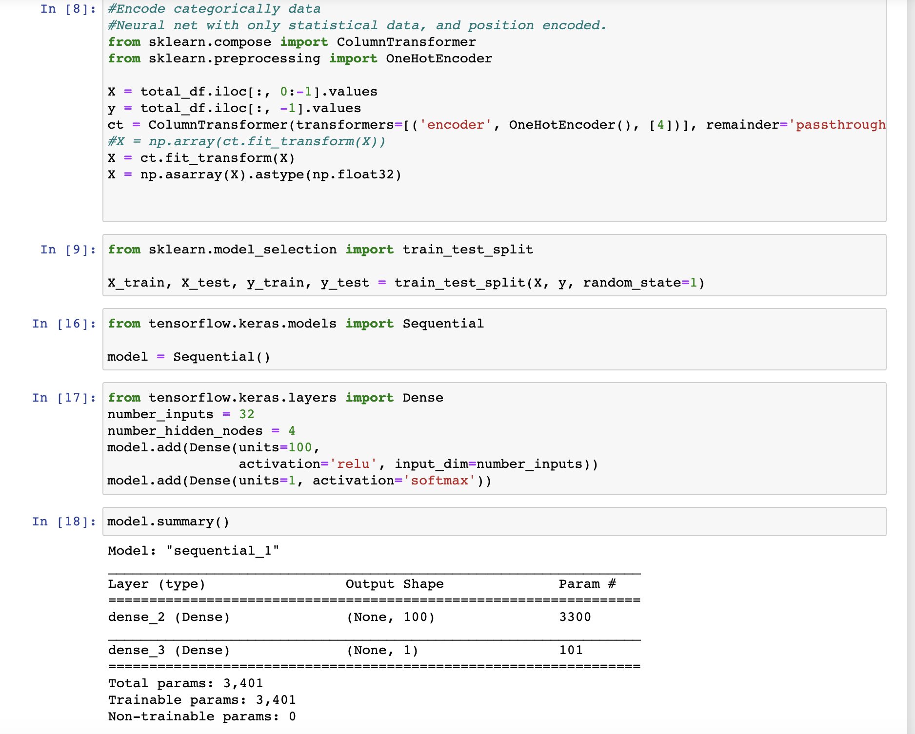
Outcome of Model
Unfortunately, the model was not very accurate predicting the number of fantasy football points a player will have week to week-10%

Slide 18

Random Forest
Combines the power of many decision trees to create one prediction.
Uses bootstrap aggregation (bagging) on the dataset to create independent decision trees.
The final decision is produced by averaging all of the predictions.

Slide 19
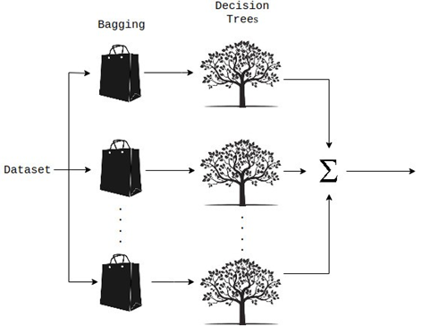
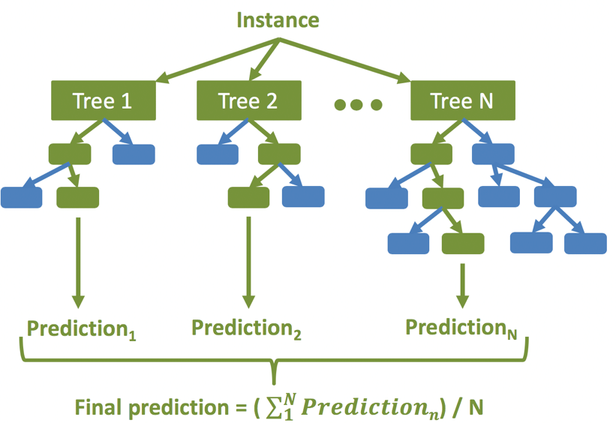
Random Forest Regression

Slide 20
Random Forest Regression- Supervised Learning
Supervised learning takes input (x) values and output (y) values to learn a mapping function that can predict new y values.
This is ideal for fantasy football predictions because we have a dataset of past statistic for players.
Using random forest we will attempt to predict Fantasy Football Points for the four main offensive players used in Fantasy Football:
Quarterback
Running Back
Wide Receiver
Tight End

Slide 21
Random Forest Regression for Fantasy Football Points Prediction
We analyzed the last year and the last seven years of the dataset.
The last seven years provides a year to year comparison for players and more data for the model to learn.
We used grid search cross validation which uses a ‘fit and score’ method to determine the best hyperparameters of our model:
Max_depth
n_estimators
Then a K-Fold cross validation determined the models performance and the negative Mean Absolute Error (MAE) was used as the error metric.

Slide 22

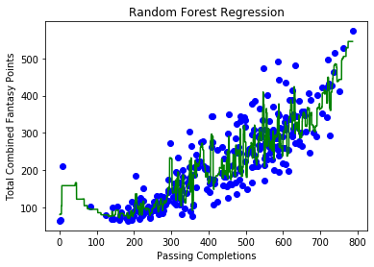

Slide 23
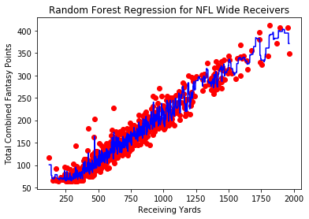

Slide 24
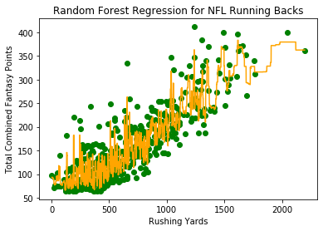
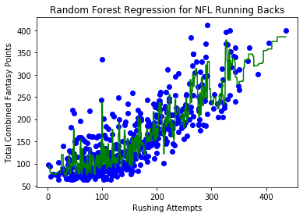
Running Back
Predictions based on rushing yards and rushing attempts

Slide 25
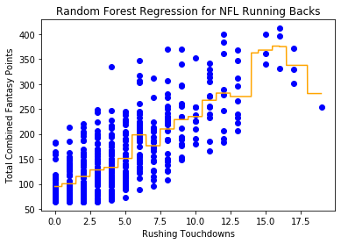
Running Back
Rushing touchdowns was not a good predictor of Fantasy Points.

Slide 26
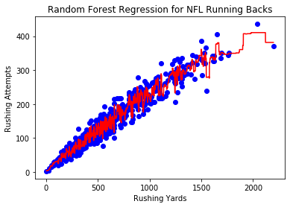
Running Back
Total number of rushing yards by a running back was a good predictor of rushing attempts.

Slide 27
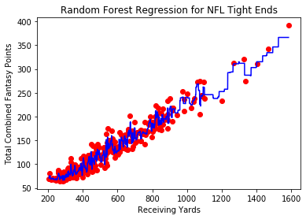
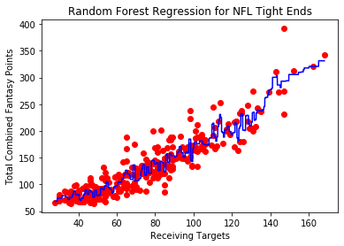
Tight End
Predictions based on receiving yards and receiving targets

Slide 28
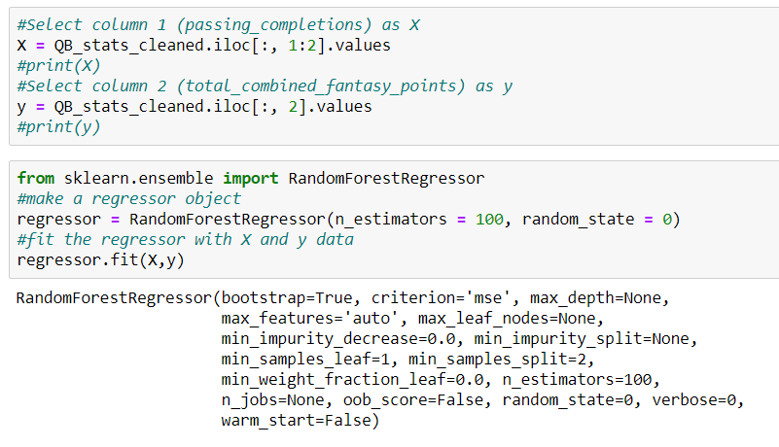

Slide 29
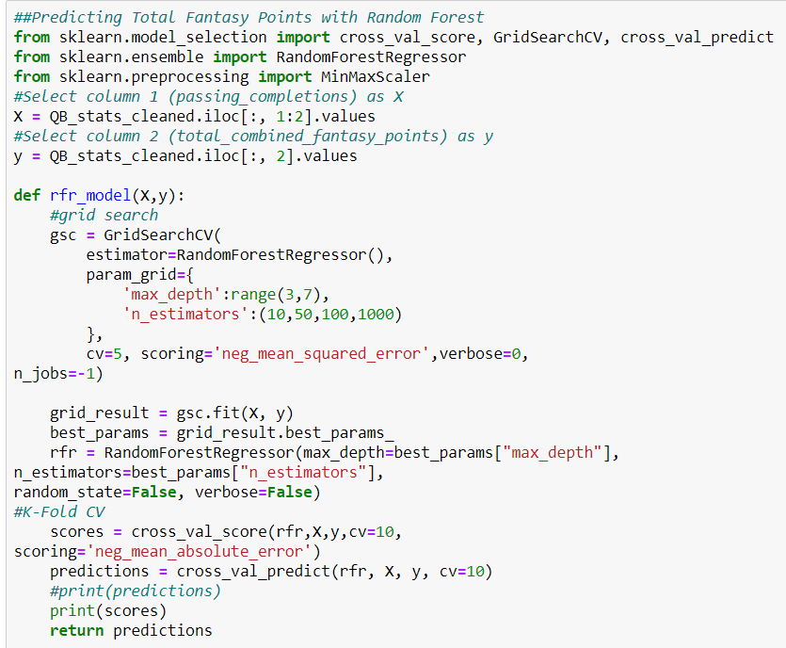

Slide 30
Tableau
All the information... organized.

Slide 31
Citations
https://towardsdatascience.com/random-forest-and-its-implementation-71824ced454f
https://medium.com/datadriveninvestor/random-forest-regression-9871bc9a25eb
https://machinelearningmastery.com/supervised-and-unsupervised-machine-learning-algorithms/
https://scikit-learn.org/stable/modules/generated/sklearn.model_selection.GridSearchCV.html

